Slide 1
MyDegreePath: Creating a GradPlan
By SNS Peer Mentors

Slide 2
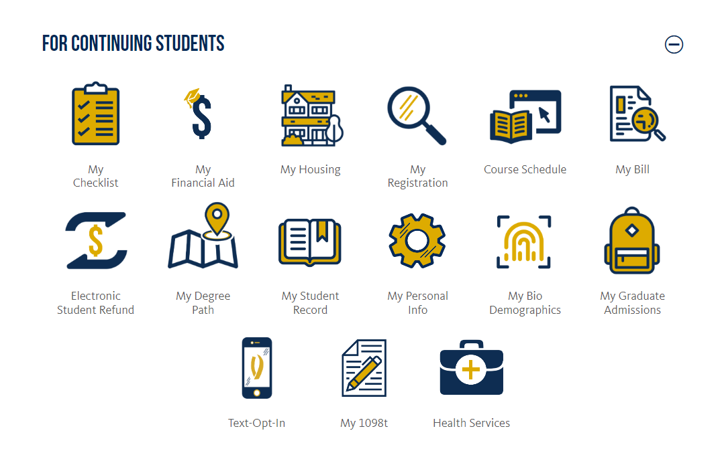
Open mydegreepath from the UC Merced connect website
Create a plan by clicking “plan” at the top

Slide 3
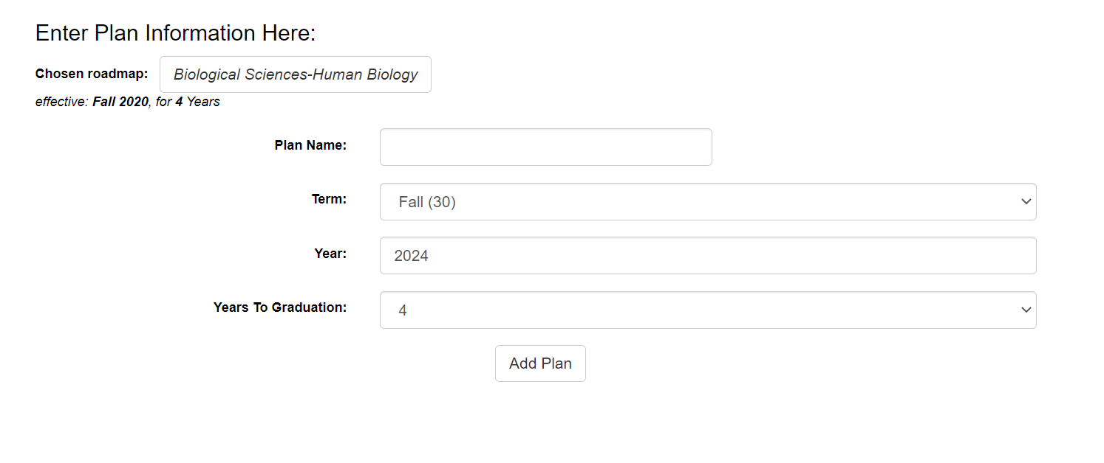
Click on “Create a new plan” and select a major of interest
Choose your catalog year (the year you enrolled/entered the UC)
For year, add the next future term
Title your plan
Click “add plan”
DISCLAIMER: You may need to refresh MyDegreePath if the catalog years do not appear

Slide 4
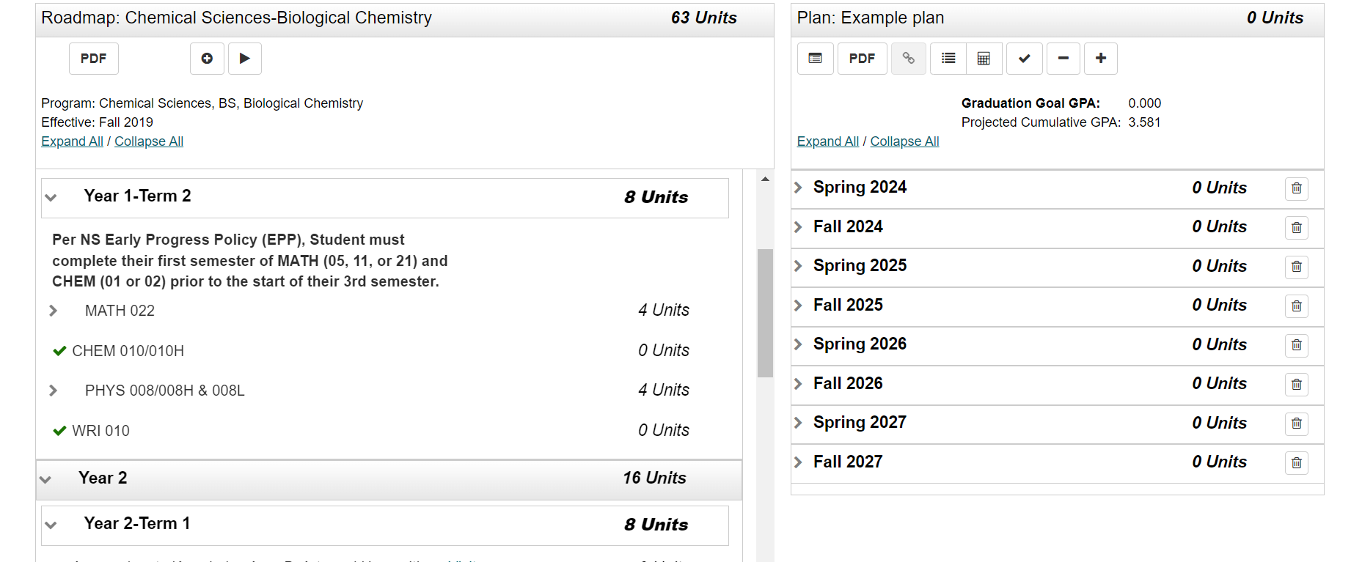
Favorite your new plan by placing a star next to it
Open the plan and start adding courses for future semesters
Disregard previous terms
Road map of classes provided by the plan chosen
Semesters where you will add
classes to

Slide 5
To calculate your GPA
To view audit against plan
To make sure requirements are being fulfilled
To add a new term
To delete all courses from plan
To create PDF of plan

Slide 6
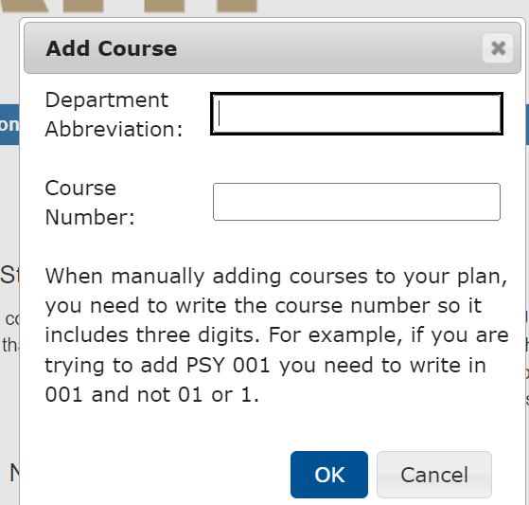
To add a new course, click add course and then type in the course you need
You can also see that you can select a certain term to add a certain class
Subject, ex: CHEM, BIO, PHYS, ESS
Course #: 001, 100

Slide 7
This is what the plan should look like after adding all the required courses: 0 units left on the left side and all planned courses on the right side
Note: You must plan a minimum of 12 units and a maximum of 18 units per semester (Not including summer semesters)

Slide 8
When a course shows up as red, make sure you have fulfilled pre-reqs or co-reqs
Click check mark at the top if you have fulfilled the requirements
If you haven’t met the requirements, click on the class and it will show you what you need to take
DISCLAIMER: If pre-reqs and co-reqs are in place and after clicking the check-mark, mydegreepath may be experiencing a glitch or check in with an advisor!

Slide 9
Click this button to view your plan against the audit after adding all the courses from the left side

Slide 10
This is what a good plan should look like! Look for any reds to acknowledge that those courses are missing from your plan!

Slide 11
Green = Classes you have already taken Purple= classes you planned to take Blue= classes you are currently taken; in progress
If you see any red, it means you are missing a course and will need to add what it is showing that you are missing

Slide 12
Come see your peer mentors!
https://ns-advising.ucmerced.edu/peermentors

